Slide 1
Asexual Reproduction

Slide 2
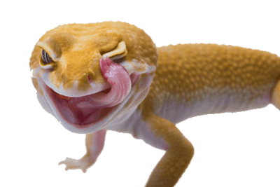
By the end of this Lesson you should be able to:
1. | State what asexual reproduction is.
2. | State what budding is.
3. | State what parthenogenesis is.

Slide 3
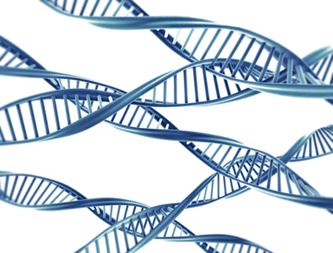
Asexual Reproduction
Asexual reproduction is essentially cloning, in that offspring are produced from only one parent.
Offspring therefore have an identical genetic make-up to the parent, resulting in similar appearance and functioning.

Slide 4
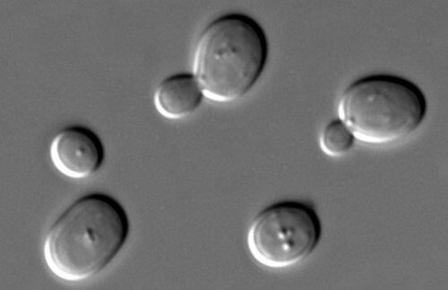
Budding
Similarly to plants, many animals can also reproduce asexually.
Starfish can grow from the arm of a parent starfish while hydra, a simple water animal, produce new offspring via budding.
Budding is a form of asexual reproduction.

Slide 5
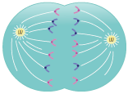
Budding II
Budding is a form of asexual reproduction in which a new organism develops from an outgrowth or bud due to cell division at one particular site.
A dividing cell:

Slide 6
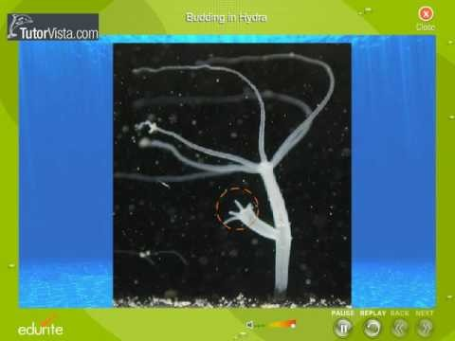

Slide 7
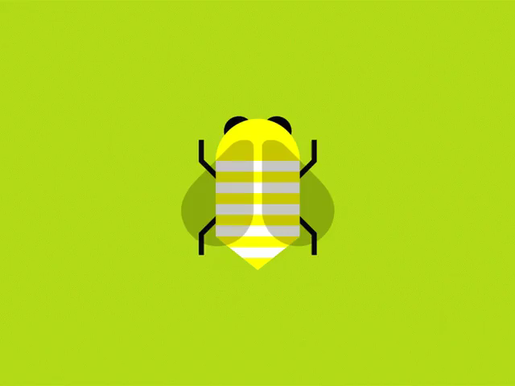
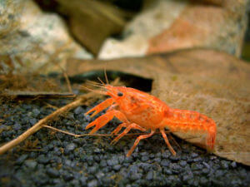
Parthenogenesis
Parthenogenesis is a more complicated form of asexual reproduction and occurs in bees, wasps, scorpions, and crayfish.

Slide 8
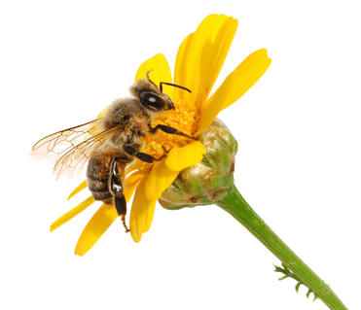
Parthenogenesis II
Parthenogenesis occurs when unfertilised eggs develop into offspring.

Slide 9
Parthenogenesis III
When no males are present, parthenogenesis has been known to occur in komodo dragons, geckos, turkeys, and hammerhead sharks.

Slide 10
